Slide 1
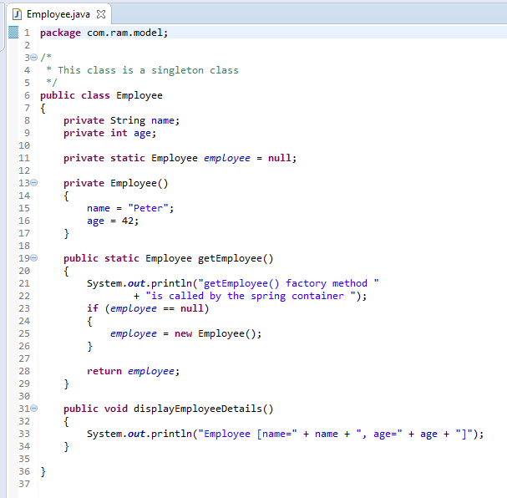
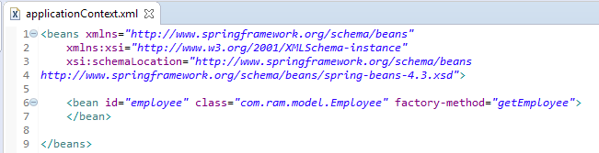
Dependency Injection with static factory method
In case of no auto-wiring mode, spring container doesn't inject the dependency by auto-wiring.
A static factory method that returns instance of its own class. It is used in singleton design pattern.

Slide 2
Dependency Injection with static factory method
What object to instantiate?
What object to configure and how to configure?
Employee
The Spring Container
(ApplicationContext)
applicationContext.xml
Animal(
Dog or Cow)
Object
Create the employee object.
Configure the employee object.
Manage employee object complete life cycle from creation till destruction.

Slide 3
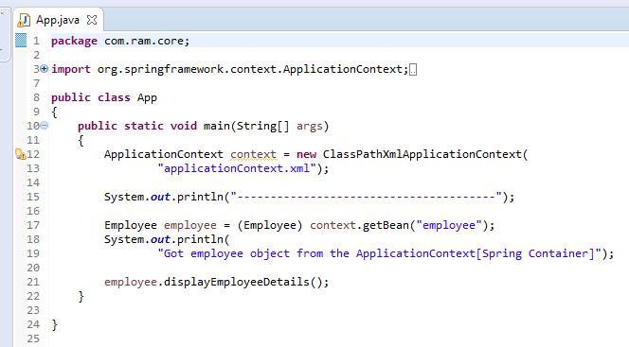
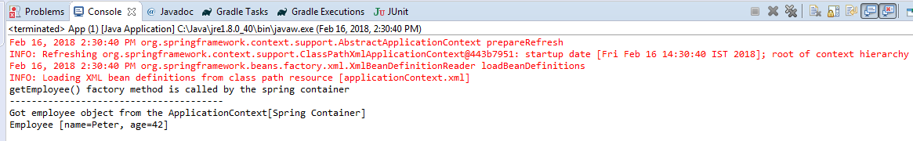
Dependency Injection with static factory method

